Slide 1

Economy: 6 pillars + theory + current + BES17 (Budget & Eco. Survey 2017)
1) Banking 2) Finance 3) Insurance, 4) Financial Inclusion
1.Banking, Fin, Insur.
6.HRD
2.Budget
3.BoP
4.Sectors
5.Infra
V1:c3,4
V1:c2,3, 6,9,11(GST),13
V1c:5
V1c:7(Textile),11(trade)
V1c:10
v1c:12, 14; Budget^Rail

Slide 2
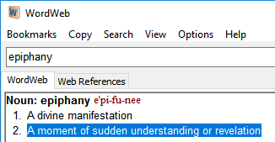
In UPSC prelims hardly 1-2 MCQs come from “Finance”, and that too requiring very superficial knowledge.
BEFORE "L2" Series
300+
After "BES171"
Finance: ~100 (incl. current, budget)
BES17
BES16
“L”
1
2
3
4
5
6
7
8
1
2
3
4
5
6
1
2*
3
4
5
6

Slide 3
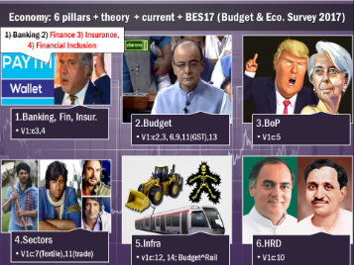

“Finance” in GS-Economy = “Medieval” in GS-History in UPSC
Prelim
Out of that “Finance (sharemarket type things)”
2014
2016
29 [Article Link]
1 [FSDC Council “yearbook”]
Economy Qs
10 [Article Link]
1 [Venture Capital = help Startup]
2015
21
0!
Then what’s the point of preparing
SEED Capital Type A, B, C!!?

Slide 4
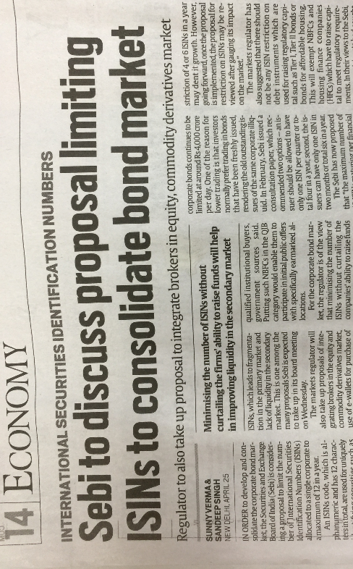
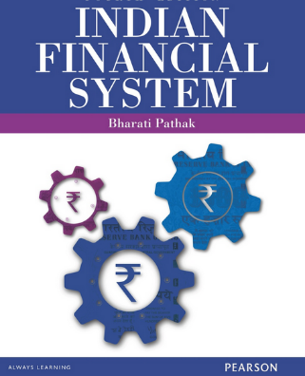
So until, UPSC starts asking technical things… no point in pursuing 500+ different topics of Financial Market / Share market / investopedia in the name of “Current Affairs”
For academic curiosity and preparation of IES (Eco), SEBI, RBI Grade “B” etc. you may refer this book’s chapters “selectively”
in BES17 series, I’ll strive for “working knowledge” rather than “technical accuracy.”

Slide 5

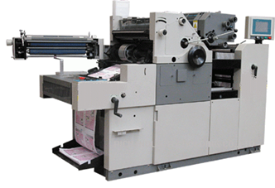

Capital
My savings
Cost of Machine
2017
Rs.5 lakh
Rs. 10 lakh
2027
Rs.10 lakh
Inflation [12L] obsolete
If SBI FD: 7%: by rule of 72: 72/7 =
~10 years it’ll take to double the money.

Slide 6

Rs. 10 Lakh required to start the printing press
Arrange Finance / Capital [10 Lakh]
Equity (Partnership, Profit Sharing, dividend)
Shares Rs.2 lakh
Debt (pay interest irrespective of profit)
Rs.3 Lakh: Bond, Debenture Loan
Promoter: 5 lakh

Slide 7

BES171: 1) Banking 2) Finance 3) Insurance 4) Financial Inclusion
Debt
Corporate Governance
Equity
SENSEX
Companies Act
SEBI & Scams
Investment Funds
Derivatives
Debt Instruments
Short term: <1 year
Long term: 1/>

Slide 8

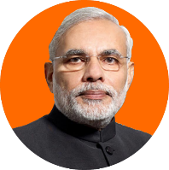

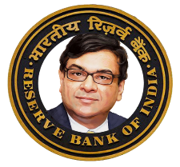
Debt Instruments: Short term => sold @discount, repurchased @Face value
Sell @discount of Rs.7
T-Bill (14 Days)
Rs.100
Profit:
100-93=“7”
Repurchased @Face Value (Rs.100) on Maturity
7.5%
Investment “93”

Slide 9

Short term debt instruments: Sold at discount, repurchased @Face Value
Govt
T-bills: 14 (only State), 91, 182, 364
Cash Management Bills: upto 90 days
Companies
Commercial papers, Promissory Notes
Banks| FI
Certificate of Deposits
Merchant to Bank
Commercial Bill [invoice sold @discount]
Maturity
<1 Year
Repo agreement: Sold @Face value, repurchased @Marked up price.

Slide 10

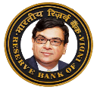

Short-term borrowing for “liquidity management”
WMA
Ways and Means advances: Government- temporary mismatch in receipt and payment. RBI helps, not counted in Fiscal deficit.
Call Money
Banks-FI inter borrowing 1 day. [usually for CRR-Adjustment] lecture link
Notice Money
Banks-FI inter borrowing >1-14 days. [usually for CRR-Adjustment]

Slide 11


Debt: fixed income, creditors, 1st Claim on liquidation
Short Term (upto 364 days)
T-Bill
Long Term (1-20….
Dated securities (G-Sec)
Bonds (UK), Debentures (US),
Municipal Bonds.
Inflation Indexed Bonds [2013] by RBI to reduce gold consumption:
1.5% + CPI but lost sheen post-inflation control
CMB, CoD
P-Notes
C-Paper, C-Bill
WMA, Call Money, Notice Money
Loan, ECB
1.44%+WPI;
Internal difference not imp.
Maturity
<1 Year
SEBI: Credit rating: >18 month

Slide 12
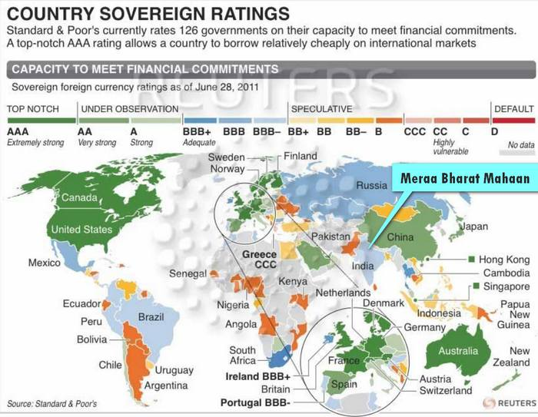
Credit Rating
Junk
Gilt Edged
Assured return
Unlikely to default on payments
But low return e.g. US Treasury bond ~2%
Company may default
But higher return: ~15-17%
Factors: Fiscal deficit, Inflation, Infrastructure, Foreign investment, GDP growth
Notes:
CRISIL, CARE, ICRA, Moody’s Fitch, S&P
SEBI 18 months

Slide 13
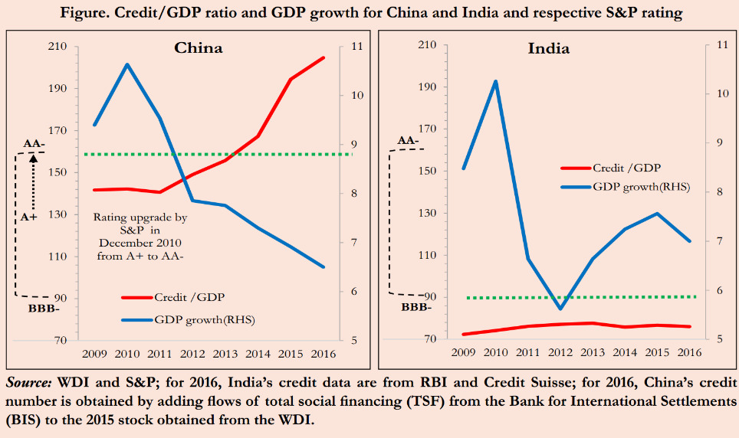

S&P: AAA rating to toxic assets that led to subprime crisis. India never defaulted on payment, yet in BBB grade, while China’s GDP growth falling yet, rank improving! – says CEA Arvind Subramanian in latest Survey 2016-17
Implications of “poor” rating on G-sec/ Sovereign bonds?
Future borrowing expensive.
Existing Bond
Issuing new bonds:
Investors Bid low amt in E-Kuber auction
Investors sell away: yield ▲
Have to be sold @bigger “discount” on face value -> %-wise borrowing expensive.

Slide 14
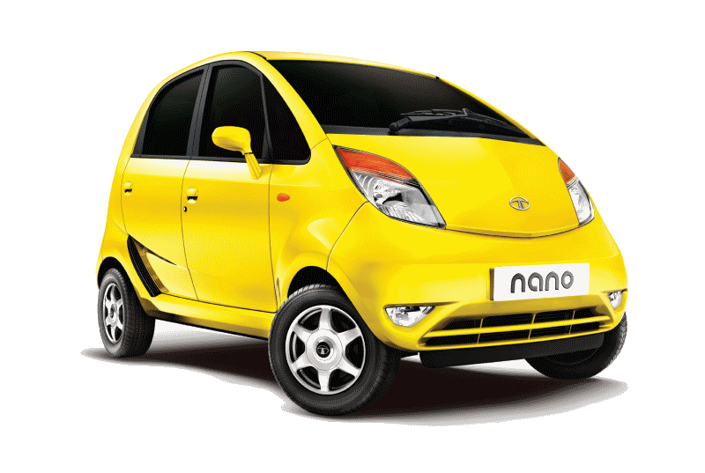
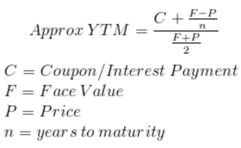

G-Sec: Bond Yield to maturity (YTM) of Rs.100 @8% on 5th year
108/100
108/90
108/80
=35%
= 20%
8% (if not sold)
Technically incorrect, just for illustration
Sells @90
Sells @80
Usually happens in “boom” when share-dividend bigger, OR when govt. is to collapse by high fiscal deficit: Greece-> rating down, next time have to offer higher% to borrow ☹
Notes:
Rs.100, @8%, 5 years
I keep it for a year (Rs.8 earned)
My yield: 8/100= 8%
Then I sell it @Rs.90
2nd buyer Current Yield: (8/90)= 8.89%
3rd buyer Current Yield: (8/80)= 10%
Yield to maturity (YTM)
Assured but Low return: US Treasury bond ~2%
Bogus Government => panic sales by investors=>Bond yield goes high
2/100=> 2%
(2/50)=>4% (higher yield)
Credit rating down: next time have to offer higher interest rate – Junk bond

Slide 15
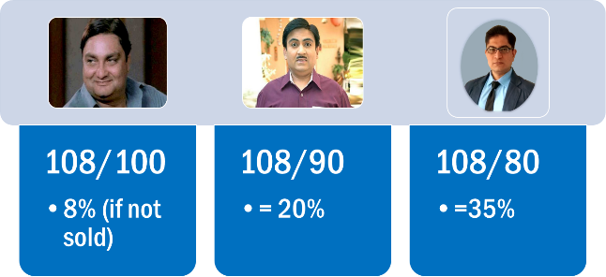


▼Bond Price=
Bond yield▲
[Inverse relation]
Sells @90
Sells @80
Similarly
Boom Period = Bond yield▲
Fear of recession, govt collapse= Bond yield▲ [if foreign investors run away]
Fear of Donald Trump imposing tax on Americans who’ve invested in India= (Indian) Bond yield▲
Sell bonds, and buy shares to get bigger dividend on profits
RBI Cheap/Easy/Dovish Money Policy:
▼RBI Interest Rates = Bond yield▲
[Inverse relation]

Slide 16
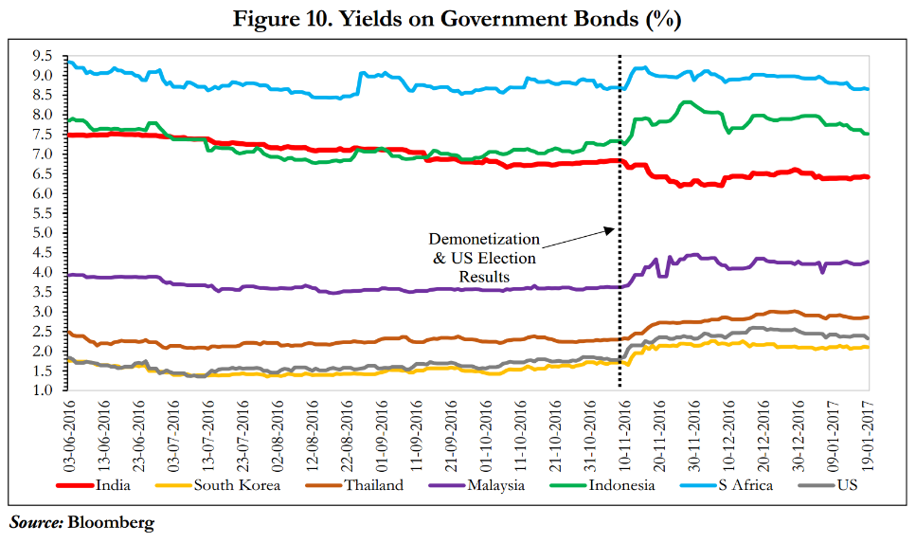

Before Bank deposit interest ▼, safer to go in G-sec ?
Other variables
Oil company’s own bonds: yield rise when crude oil price fall, because company may ‘collapse or default”, so better sell oil co’s bonds & run away.
Even Shale Gas Co’s bond yield will rise, because if oil is cheap, only idiot will buy shale gas-> they may also default. BUT IF Trump gave subsidies to shale cos, yield may not fall, but then US treasury Bond’s yield may rise on account of high fiscal deficit… <and so forth PH.D. goes on……>

Slide 17
Mock question for prelims
India’s sovereign bond yield will rise when _____ .
RBI pursues cheap money policy
Rating agencies degrade India’s sovereign credit rating.
Indian economy is undergoing a boom period.
Answer Choices
a. Only 1 and 2 (b) Only 1 and 3
c. Only 2 and 3 (d) all 1, 2 and 3

Slide 18
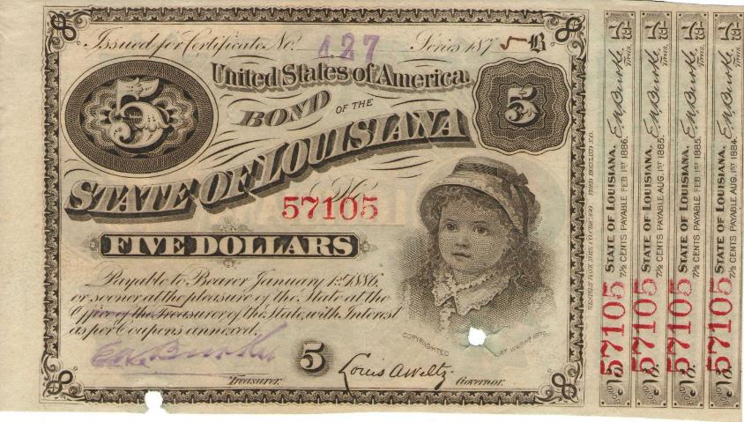
Coupon bond
Coupons
7.5 cent x 4 years = $0.30 cents.
$0.30 / 5 = 6% interest on coupon bond.

Slide 19
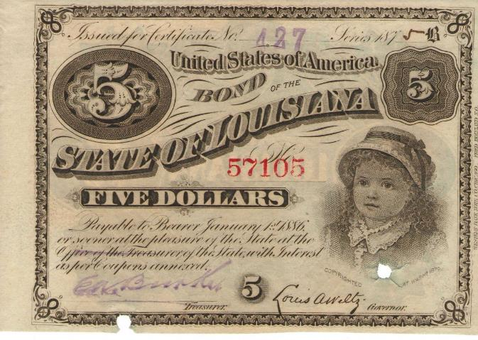
ZERO Coupon bond = “bond without coupons”
Bearer bonds:
no name, records
Usually in war times.
Sell at discounted price of $4
Purchase at face value of $5 after 4 years.
Interest paid: ¼=25%

Slide 20
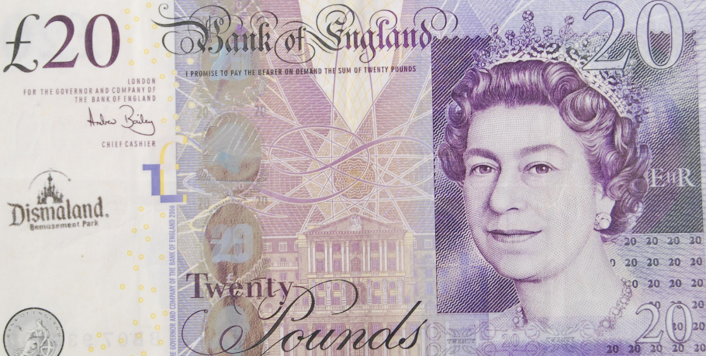
Fiat Money: more in this lecture link
Currency: zero interest, anonymous bearer bond.

Slide 21
BES171: 1) Banking 2) Finance 3) Insurance 4) Financial Inclusion
Debt
Corporate Governance
Equity
SENSEX
Companies Act
SEBI & Scams
Investment Funds
Derivatives

Slide 22

Capital [10 Lakh]
Equity (Partnership, Profit Sharing)
Shares Rs.2 lakh
Debt (pay interest irrespective of profit)
Rs.3 Lakh
Promoter: 5 lakh

Slide 23
Equity: IF profit-> sharing (Dividend)
Feature
Types
Last claim during liquidation
**% out of 100%
Owners, Proprietors to company
Ordinary Shares
VCF-> Professional firms helping startup cos. <seed capital: to start biz.>
Angel Investor-> rich individual helping startup cos. Like a “timepass” rather full time profession. <Azim Premiji, Ratan Tata>
Preferential shares with or without voting power.
Income not fixed.
Dividend Tax @company (before giving to investor)
Notes:
Stamp duty computation –but not important.
Bond: Government / PSU
Debenture: private ??

Slide 24


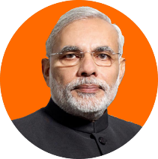
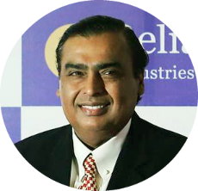
Taxability
Even here also 10% tax if> 10 lakh dividend [@Destination]
Income Tax @destination
Dividend distribution tax
@source
Remaining amount
Rs. 7.60
5% TDS
Equity (100) Share
Debt (100) Bond @8%
@Rs.8 Interest
Capital [200]
@Rs. 10 dividend
Boom
Slowdown

Slide 25
Mock question for prelims
Find correct statement(s) about taxability of financial instruments in India?
Share dividend is taxable at source
Bond interest is taxable at destination.
Both A and B
Neither A nor B

Slide 26
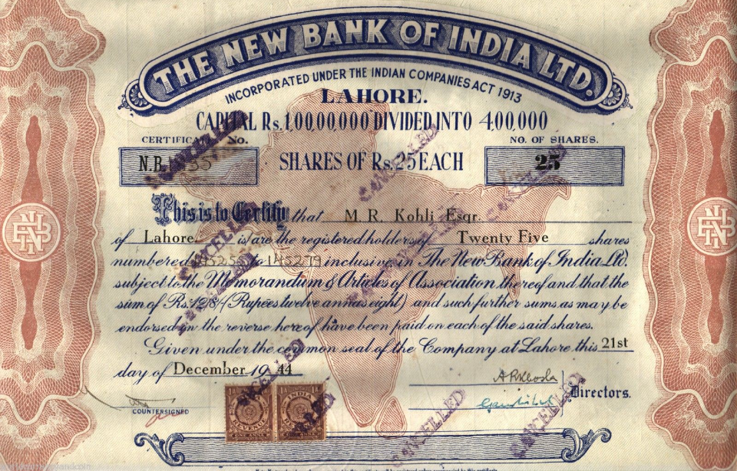
Face value Rs.25 x 4 lakh shares = 1 cr. Paid up capital.
Authorized capital could be higher, say 2 cr.
25/4 lakh = ownership
0.00625%
Face Value

Slide 27

Share prices
Face value/ par value
Can be any integer
1,2,5,8,10,20,25, 50,100
But not decimal: 1.50……x
IPO < face value ….x [unlike T-Bills]
Premium Value
Rs.10 share with Rs.30 premium
Rs. 10 + 30 = 40
Sweet Equity: shares sold @discount to directors, employees for their value addition to cos as IPR, know-how etc. [but regulated under Companies Act]
Notes:
Rs. 10
(1999)

Slide 28






How to issue shares for the first time “Initial public offer”?
Underwriter
Promoter
Public issue
Underwriter
US: Investment banker
UK: Merchant Banker
1) Fixed price and 2) book building method.
ASBA: application supported by blocked amount [amount debited only if shares allotted]
Proposed: E-ipo to increase retail participation
Notes:
Red Herring: Offer price & date not given
US: Investment banker
UK: Merchant Banker

Slide 29
Equity finance: “Issue Types”
1981: Infosys [private ltd, unlisted]
Public Issue
Follow on FPO
Rights issue
Pvt issue
IPO
Preferential shares
Qualified institutional placement
Voting power/!
First existing investors as per existing holding
ELSE aam-junta
If additional capital required, afterwards…
Esp. When company wants equity finance, but law, FDI norms doesn’t permit so without voting. e.g. Basel

Slide 30


Share splitting (SBI had done in 2014)
Equity Capital: 100
Promoters: (90)
Rs.10x1 share
=Rs.10
Rs.1 x 10 shares
= Rs.10
“liquidity” to investor. Easier to sell smaller denomination
Doesn’t change value or shareholding of the company

Slide 31
Bonus shares (FREE)
if not sufficient profit to generate dividend, then?
Equity Capital: 100
Promoters:: (90)
Face Value 10x1 share=10
+Bonus share 1:2
Sell 2 new shares to third party…to earn money (Rs.20)
I got them for free! But if I sell them, then in future, dividends ▼ because of more shareholders ☹

Slide 32
Before we go into share buyback…
Revenue
- interest to Debenture/bonds/loans/ECB
- salary, Expenditure, input cost
- Taxes [corporate, excise, service]
- dividend to preferential shares
- dividend to ordinary shareholders
====
Reserve / Company’s Retained Earnings
TCS ~38k crores.

Slide 33

TCS: Face value Rs.1, premium value Rs. 2850 (buyback, 2017, Feb)
Retained earning?
Share buyback (1998)
Promoters shareholding ▲
Less dividend to ‘outsiders’
Expansion
Acquisition
Subsidiary companies
Issue bigger dividend next time
Big offer-> next FPO people motivated to buy
But tax on dividend ☹
@source + @destination (if >10L)
No tax on buyback ☺
Reliance: 2012
TCS: 2017 [2.85% absorbed]
Notes:
http://www.thehindu.com/business/Industry/the-lowdown-on-the-tcs-buyback-offer/article17369818.ece
http://www.business-standard.com/article/news-ians/tcs-to-buy-back-shares-worth-rs-16-000-crore-117022000692_1.html

Slide 34



What is American Depository(ADR) & global depository receipt (GDR)@EU?
Shares
Dividend
$$
ADR
Because if directly wants to list @NASDAQ, then SEC permission, accounting norms etc.
NASDAQ
Bharat Depository receipt (BhDR) and IDR…
similar if Arnold wants to mobilize from indian market.
Notes:
DR : Depository receipt
Kingfisher=> NASDAQ (SEC permission, accounting norms)
Kingfisher => Indian shares @Bank of America (investment banker)
BoA => Kingfisher ADR=> NASDAQ
10 desi shares = 1 ADR [$ paid, $ dividend]
GDR= Global depository receipts @EU
1st GDR: Reliance '92
1st ADR: Infosys '99

Slide 35
BES171: 1) Banking 2) Finance 3) Insurance 4) Financial Inclusion
Debt
Corporate Governance
Equity
SENSEX
Companies Act
SEBI & Scams
Investment Funds
Derivatives

Slide 36






Mutual fund
NAV
Unit
Unit
Unit
Portfolio (AMC)
Fund manager
EXIT LOAD
Notes:
NAV fluctuates daily.
Definition: Mutual funds companies collect an amount from investors when they join or leave a scheme. This fee charged is generally referred to as a 'load'. Exit load is a fee or an amount charged from an investor for exiting or leaving a scheme or the company as an investor. Description: The aim behind the collection of this commission at the time investors exit the scheme is to discourage them from doing so, i.e. to reduce the number of withdrawals by the investors from the schemes of mutual funds. Different mutual funds houses charge different fees as an exit load.

Slide 37
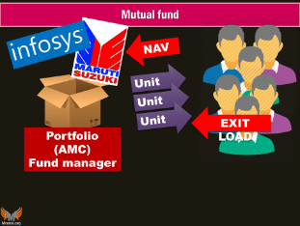
Types of Mutual funds?
Types
Nature of portfolio
Risk on return
Equity
Debt
Gilt-edged
Real-estate, Energy
Growth
Balance
Income
Debt to equity: 20:80
50:50
80:20

Slide 38


Hedge Fund = pvt MF for HNI wanting high returns
In the black money lecture
HNI Clients: Min. 1 cr investment
SEBI regulations not strict.
Although lost shine after GFC
Junk bonds
P-Notes
Arbitrage
Risky Assets
Leverage
Short-selling
Unit
Unit
Unit
Portfolio (Hedge Fund)
Technically “Alternate investment funds”
Notes:
NAV fluctuates daily
HNI=> private MF
SEBI: min. 1 crore investment (SBIMF-100)
Karvy Capital, Motilal Oswald etc.
SEBI regulation…not strict like MF
Alternative investment fund Cat.III
High risk, high reward
100 Cr. Pooled=> bet upto Rs.200 crore (T+2)

Slide 39





REITs: Real estate investment trusts
Investors: HNI / institutions. Min. 2 lakh per applicant
Return
Units Sold
Invested Rs.
RENT
Fund Manager
SEBI regulates
Finished / soon to finish rent generating assets. Agri..X; mortgaged..X

Slide 40
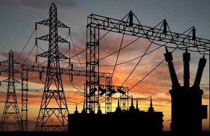

InvITs: infrastructure investment trusts
Investors: HNI / institutions. Min. 2 lakh per applicant
Return
Units Sold
Invested Rs.
RENT, Toll, user fees
Fund Manager
SEBI regulates
Min. networth Rs.100 million
airport, highway,
thermal plants, gas grid

Slide 41
Mock question for prelims
In India, which of the following investment funds, are meant only for the high net worth individuals (HNI)?
Exchange Traded Funds (ETF)
InvITs: infrastructure investment trusts
REITs: Real estate investment trusts
Hedge Funds
Answer Choices
a. Only 1 and 2 (b) Only 4
c. Only 2 and 3 (d) Only 2, 3 and 4

Slide 42

REITS INVITS
Benefits
Tried tested in US, UK, Aus., Japan
Stressed developer gets new finance: else NPA
New investment opportunity for people [dividend distribution tax..X*]
Unit can be sold in stock exchange : don’t have to wait till maturity [but capital gains tax yes]
2017, Apr: RBI allowed banks to invest net owned funds in this upto 10% <NOT NDTL>

Slide 43
Disinvestment: Government shareholding [100%- upto 51%]
ONGC
Coal India
IOC
GAIL (India)
Oil India
PFC
Bharat Electronics
REC
Engineers India
Container Corporation of India.
10 CPSE-> 2014: shares given to Goldman Sach MF
Exchange traded Funds

Slide 44


CPSE-ETF: Exchange Traded Fund
ONGC, CIL, GAIL
10 CPSE
Rs.3000 cr.
NFO
Rs.10
Rs.10
Rs.10
Rs.12
Portfolio Goldman Sach
BSE-NSE
Notes:
NAV fluctuates daily

Slide 45
ETF: Exchange Traded Fund
ONGC, CIL, GAIL
10 CPSE
Rs.3000 cr.
6000 cr.
2500 Cr.
NFO
Further fund offer
Rs.10
Rs.10
Rs.10
Rs.12
Portfolio Goldman Sach
Reliance MF (2015)
Aquired G.Sach
BSE-NSE
Notes:
NAV fluctuates daily

Slide 46
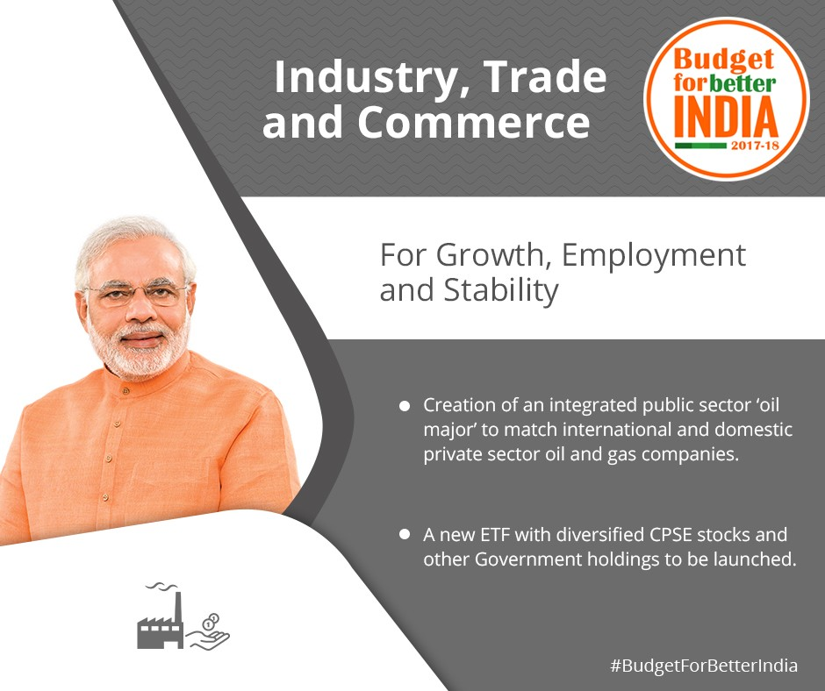
Exchange traded Funds
Our ETF, comprising shares of ten PSUs, has received overwhelming response
Will launch new ETF with other PSUs

Slide 47
BES171: 1) Banking 2) Finance 3) Insurance 4) Financial Inclusion
Debt
Corporate Governance
Equity
SENSEX
Companies Act
SEBI & Scams
Investment Funds
Derivatives

Slide 48
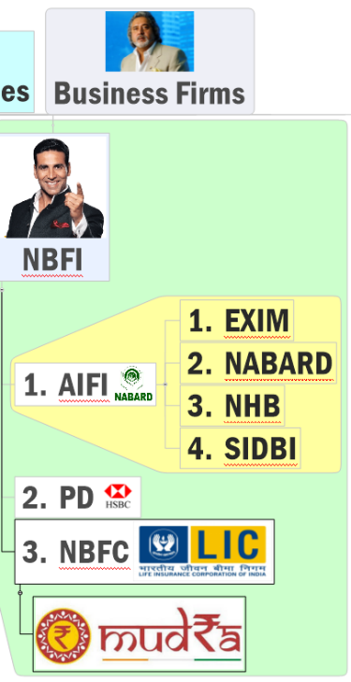
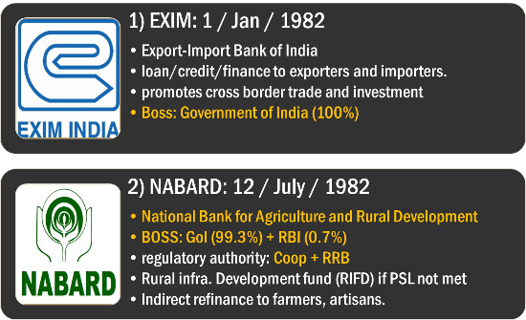
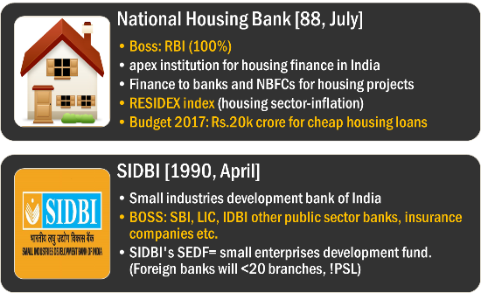

Slide 49







Mortgage backed securities
(Derivatives)
Securitization
refinance

Slide 50
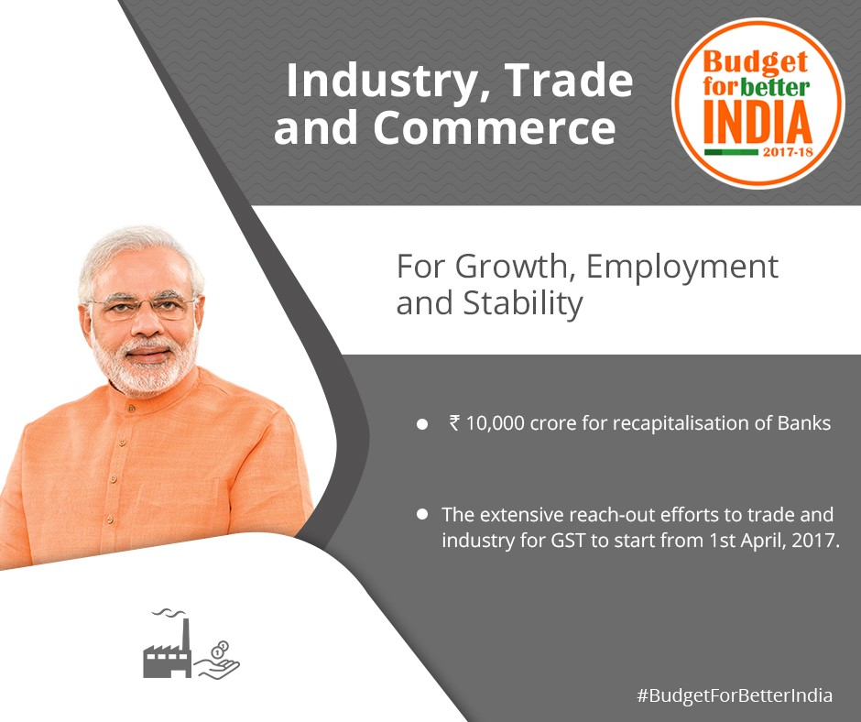
Securitization
SARFESI: Asset reconstruction companies ARC (RBI regulated NBFC) can list securitization receipts @stock exchange.
Will help NPA resolution.

Slide 51






Mortgage backed securities
“Derivatives”
Subprime Crisis (2007-08)
Global Financial Crisis GFC (2008)
Subprime
Borrowers
Without capacity repay
2000 : Credit Information Bureau (India) Limited
Credit Information Companies (Regulation) Act, 2005 them RBI licenses
Notes:
For many Wall Street watchers, Fabrice Tourre personified the kind of callow, shortsighted computer who engineered the 2008 economic meltdown. Hired by Goldman Sachs shortly after receiving his Master's in Operations Science from Stanford University, Tourre quickly rose to become Vice President of the Structured Trading desk. In 2007, he helped create Abacus 2007-AC1, a mortgage-backed security that bundled toxic sub-prime mortgages. Goldman sold Abacus to its customers, while simultaneously making short bets against it. As the housing bubble burst, Abacus' value plummeted, hurting its investors but guaranteeing a huge payday for other Goldman customers -- including hedge fund manager John Paulson -- who had taken the short bets. In return for orchestrating the deal, Tourre was made executive director of Goldman Sachs' London office.

Slide 52
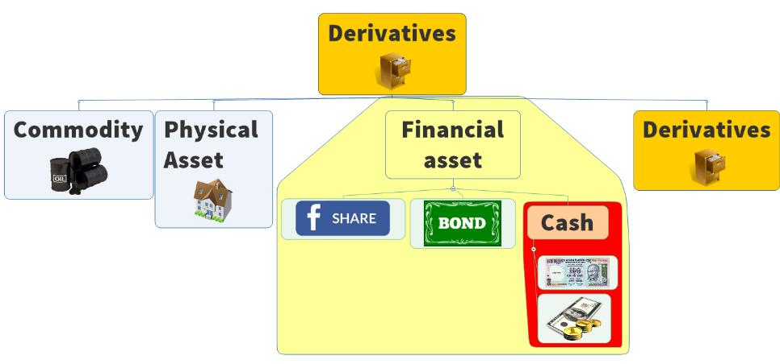
So there are three types financial instruments
Derives value from another “ASSET”
Debt
Equity

Slide 53

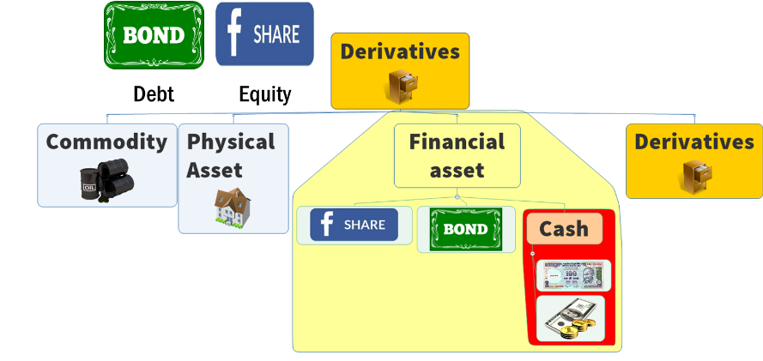
Sell, purchase, execute @later date
Forward contract
Buy “insurance” to minimize “risk”
Call Option [right to buy, no obligation to buy]
Future contract
Put Option [right to sell, but no obligation to sell]
Three parties
Buyer
Seller
Insurer (writer)- premium
SWAP is derivative instrument to swap one financial asset with another (incl. CASH) More in BES17 “3” (BoP)

Slide 54




Credit Default Swap (CDS)
BONDS
CDS
Bond
Money
Credit Default Swap agreement: against default “Risk”
Currency Swap agreement: against exchange rate “Volatility”
Interest swap agreement: against interest rate “Volatility”

Slide 55


By Settlement
Spot Market
Future Market
By Securities
Debt
Equity
Derivatives
Budget-2017
Will integrate these two, and E-NAM…better prices to farmers

Slide 56
BES171: 1) Banking 2) Finance 3) Insurance 4) Financial Inclusion
Debt
Corporate Governance
Equity
SENSEX
Companies Act
SEBI & Scams
Investment Funds
Derivatives

